Slide 1

Music recommendation service based on Facial Emotion analysis
SuYoung
SoHyoun
HyeWoo
SangJun

Slide 2

1. Project Overview and Purpose
2. Project teaming and roles
3. How to Collect and Analyze Data
Agenda
4. System Flow and Architecture
5. Modeling
6. System Operator Guidelines
7. Problems and Solutions
8. Conclusion and Review

Slide 3
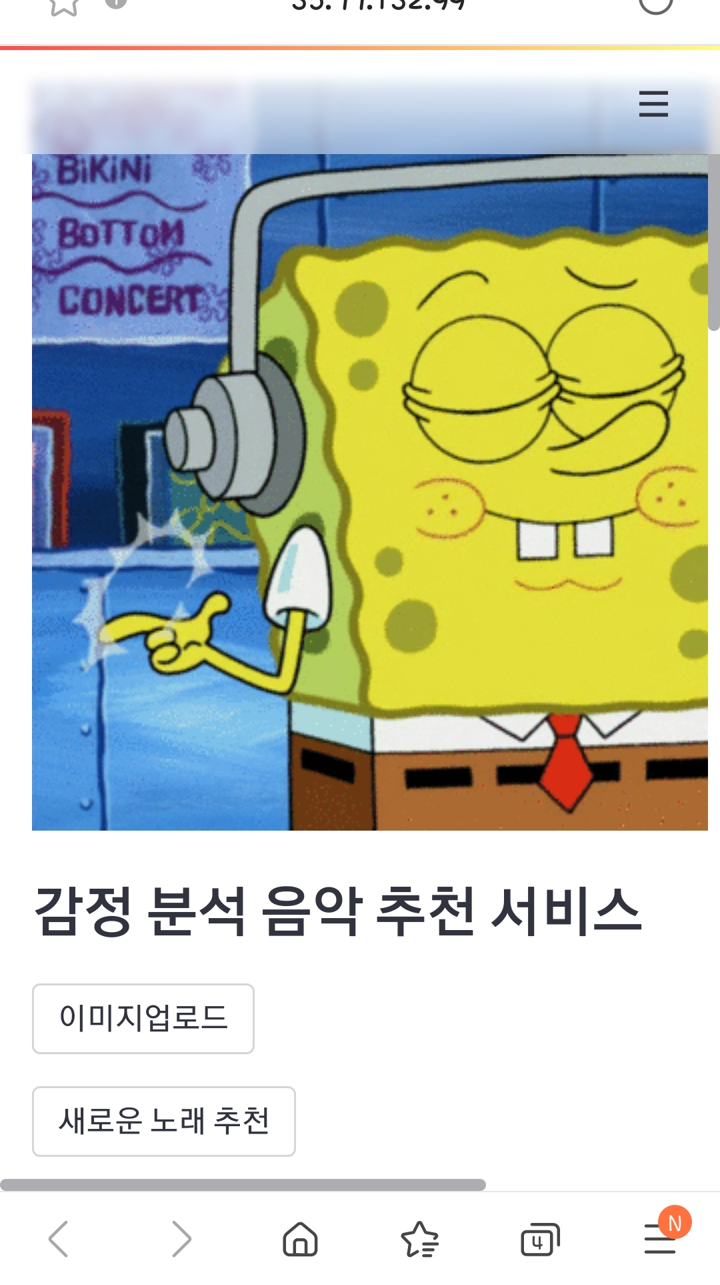
01
Project Overview and Purpose
Music recommendation service based on Facial Emotion analysis
the rapid development of artificial intelligence
One of the important means of expressing emotions is facial expressions
Understand by experiencing emotion analysis, deep learning modeling and web server deployment firsthand
Purpose of consumer UI by creating various and interesting services using API
Simple PowerPoint Presentation

Slide 4
02
Project teaming and roles
SangJun
HeyWoo
-R&D for Web Service Implementation -Streamlit Web Publishing Job -Function to upload neutral emotion photos -AWS Configuration and Web Deployment -QR code distribution
-FER2013 and haarcascade deep learning -Implementation and Efficiency of Use Learning Model -The OpenCV setup and capture function -Streamlit Web Publishing Job
TeamLeader: SuYoung
SoHyoun
-FER2013 and haarcascade deep learning -Implementation and Efficiency of Use Learning Model -The OpenCV setup and capture function -Streamlit Web Publishing Job -Presentation
-R&D for Web Service Implementation -Streamlit Web Publishing Job -Implementing Neutral Emotional Detail User Selection -AWS Configuration and Web Deployment -QR code distribution
.

Slide 5
03
How to Collect and Analyze Data
Data
Filtering
About 500
Fer2013
AI Hub
Data
About 500
New data 20297
Happiness 7295
Sadness 4839
Surprise 3197
Neutral 4966

Slide 6
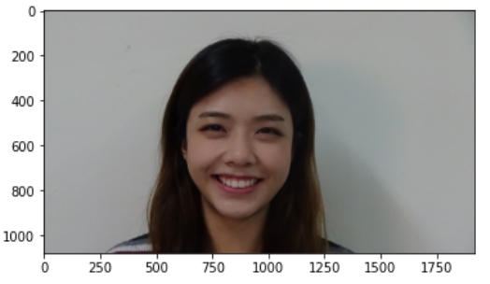
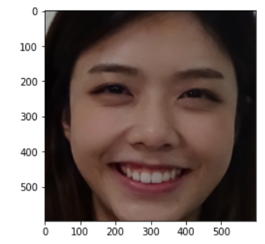
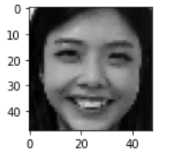
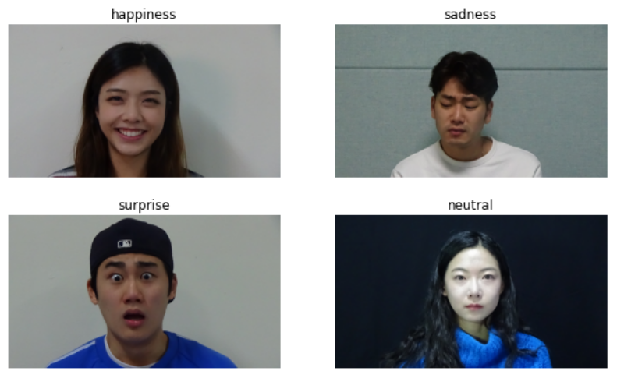
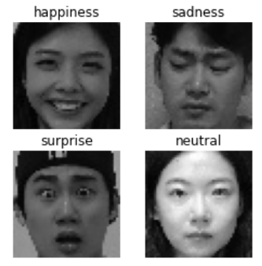
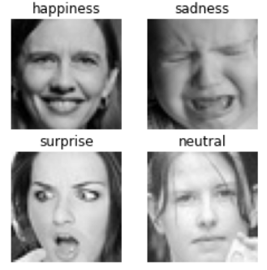
03
How to Collect and Analyze Data
haarcascade
Face crop
GRAYSCALE
RESIZE(48,48)

Slide 7
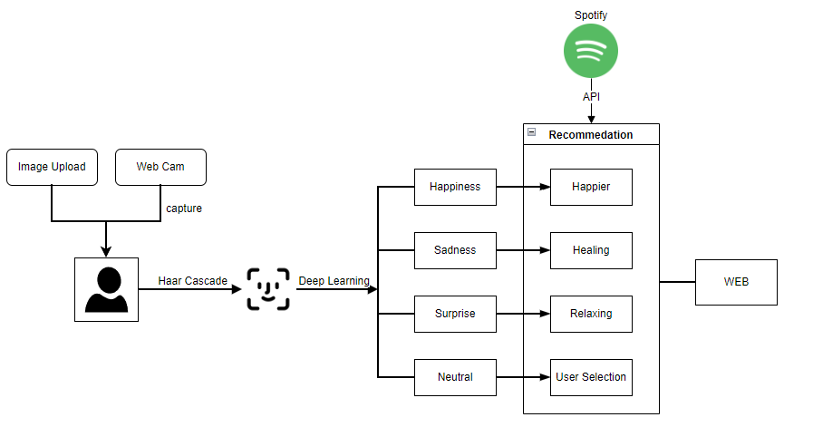
04
System Flow and Architecture
<Flow>

Slide 8
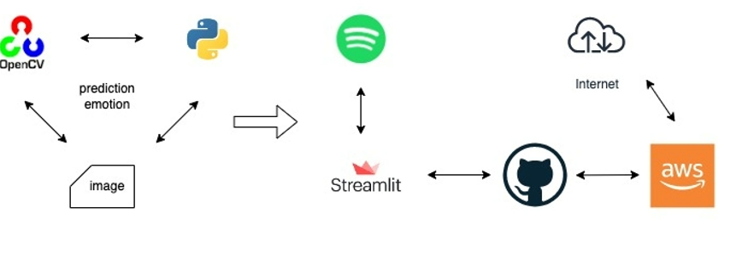
04
System Flow and Architecture
<Function>

Slide 9
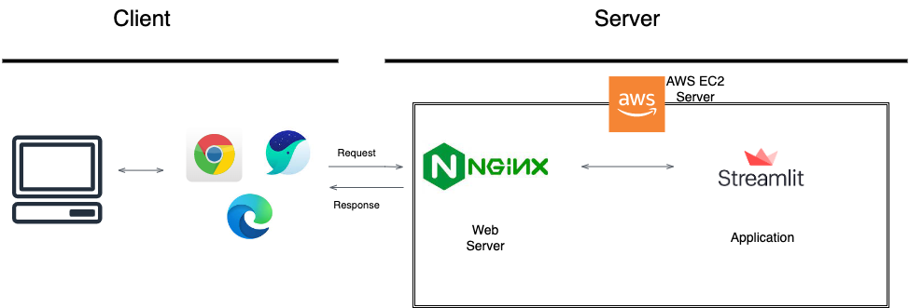
04
System Flow and Architecture
<Architecture>

Slide 10

04
System Flow and Architecture
Spotify Music recommendation method
User
User Information
Searching
Recommendation
of candidate songs
Playing music
Music streaming
Creation of Spotify playlist
API for developers
Playlist_id
Spotify service platform

Slide 11

04
System Flow and Architecture
Main Library Streamlit
First Application Development Framework for Machine Learning and Data Science
Easy to create prototypes.
Built with simple Python code.
Dashboard UI can be configured by providing various components
Backend development or HTTP requests No need to implement.
Provides record functionality to record screen

Slide 12
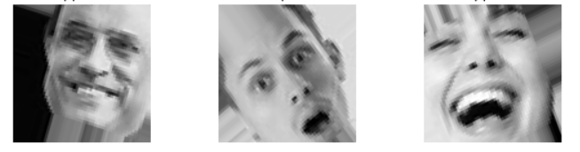
05
Modeling
convolution layer + Augment
Categorical crossentropy
1 Block
2 Block
3 Block
Fully Connected Classifier
Conv (64)
Softmax/Sigmoid
Conv (64)
Maxpool
Conv (64)
Conv (64)
Maxpool
Conv (64)
Conv (64)
Maxpool
Dense (64)
Flatten
Dense (64)
Drop out (0.5)
Augment

Slide 13
05
Modeling
ResnetV50 + Augment
Zero padding
Conv
BatchN
ReLu
Max Pool
Conv Block
ID Block
Conv Block
ID Block
Conv Block
ID Block
Conv Block
ID Block
Avg Pool
Flatten
FC
Augment
Functional
Softmax / Sigmoid
Dense (4)
GlobalAvgPooling
Batch Norm (512)
Dense(512)
After freezing, add layer

Slide 14
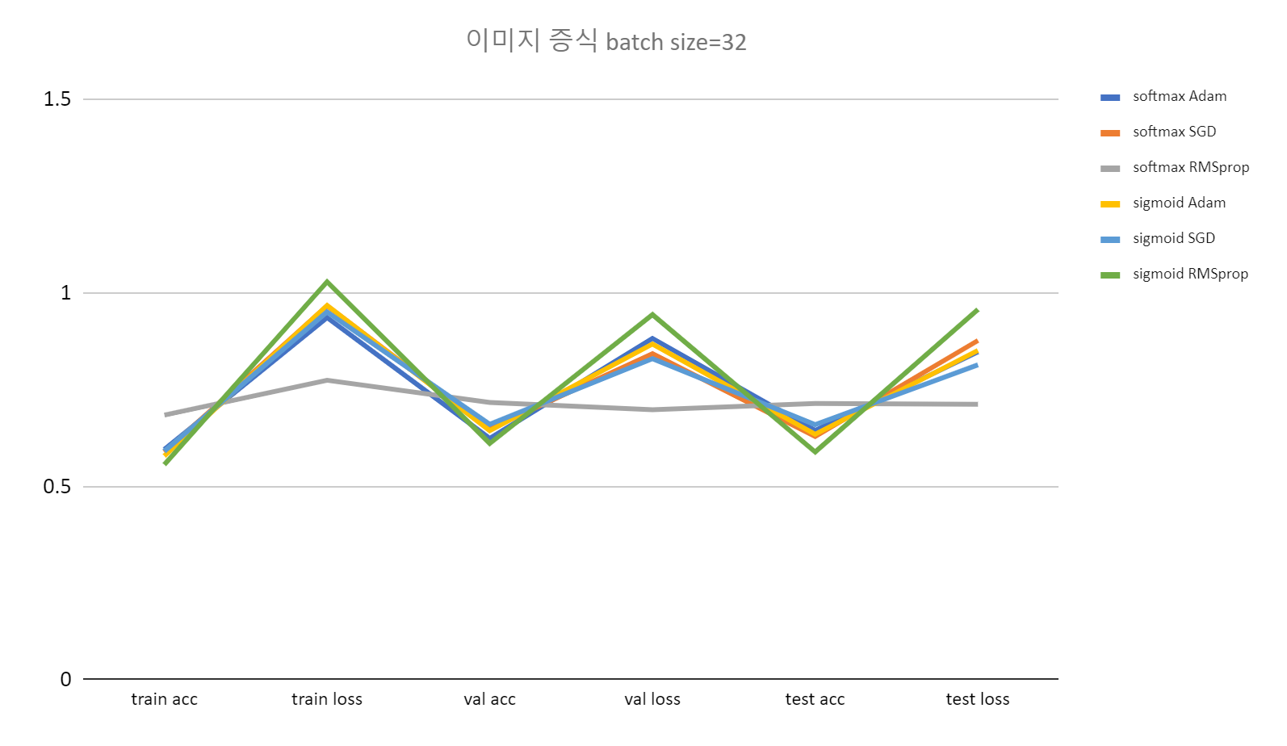
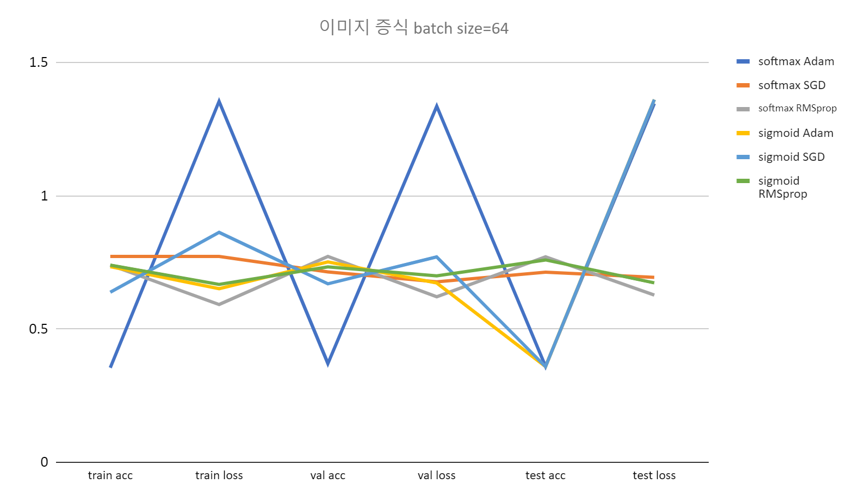
05
Modeling
Convolution layer
batch/ epoch | Activate | optimizer | train acc | train loss | val acc | val loss | test acc | test loss
64/50 | softmax | RMSprop | 0.7396 | 0.5916 | 0.7722 | 0.6207 | 0.7707 | 0.6273
Add: Model’s acc.xlsx - Google Sheets

Slide 15
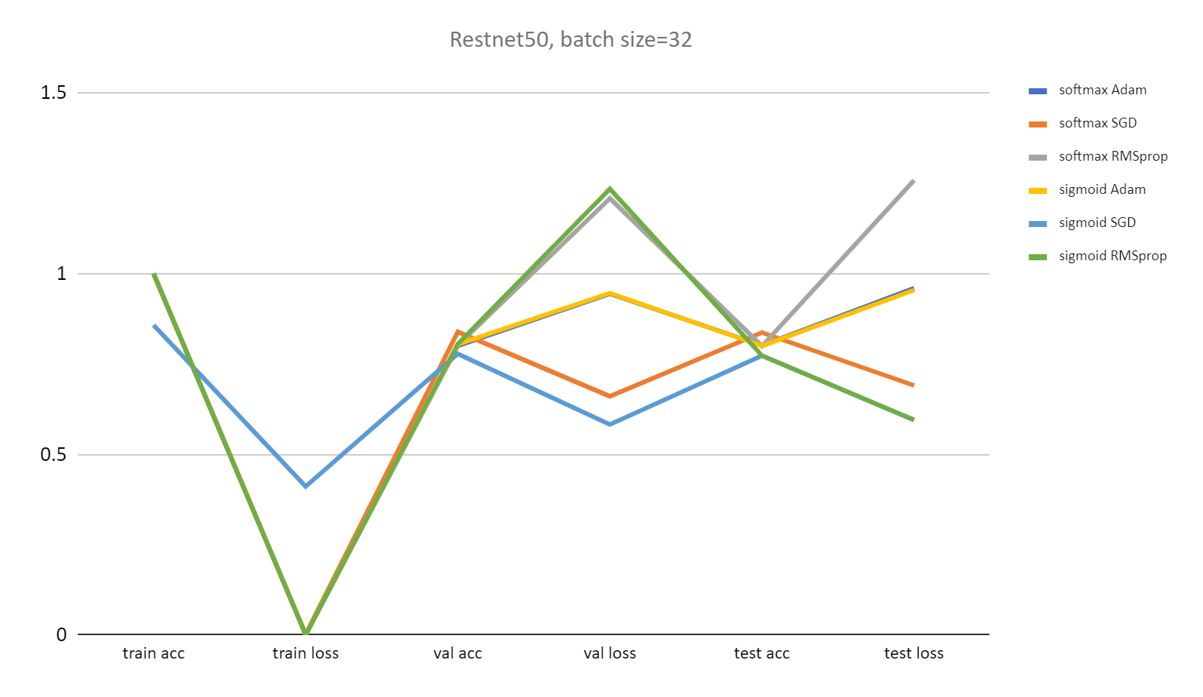
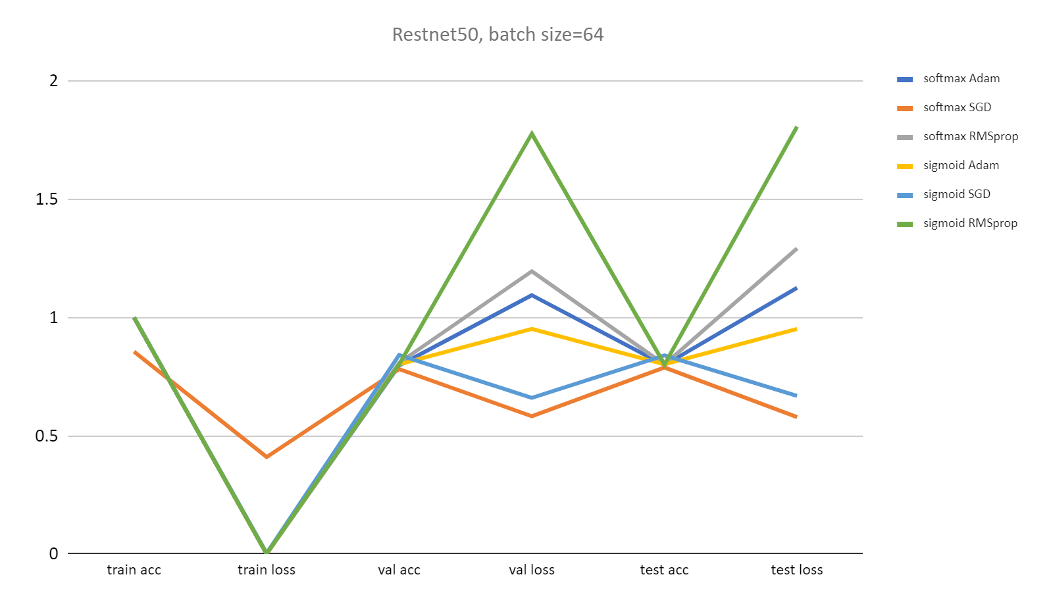
05
Modeling
ResnetV50
batch/ epoch | activate | optimizer | train acc | train loss | val acc | val loss | Test acc | test loss
64/50 | softmax | SGD | 0.8556 | 0.4095 | 0.7812 | 0.5819 | 0.7883 | 0.5786

Slide 16
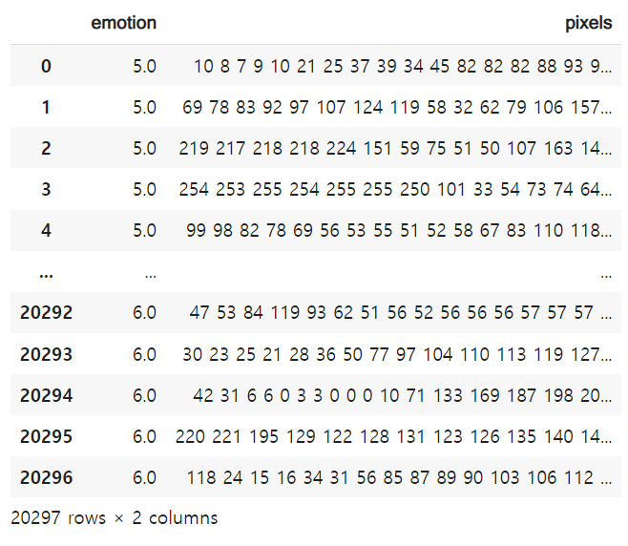
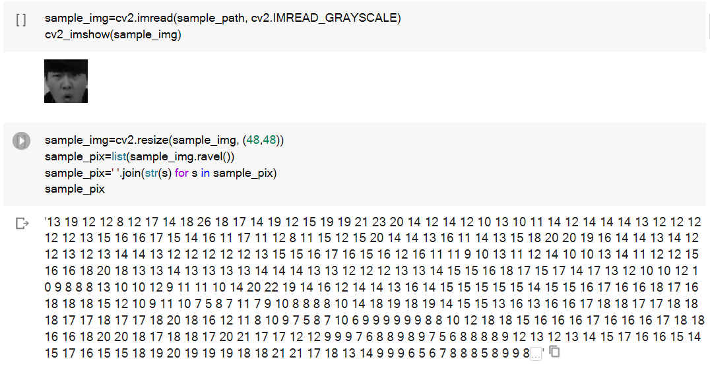
05
Modeling
Make to increase a model acc
Convert Image to Numpy Array
Emotion, Pixel Integration, Save as DataFrame

Slide 17
05
Modeling
ResnetV50
Sparse categorical crossentropy
Functional
BatchN
Flatten
Dense
BatchN
Drop out
Dense
BatchN
Drop out
Dense
BatchN
Drop out
Dense
Softmax
Augment
batch/ epoch | activate | optimizer | train acc | train loss | val acc | val loss | test acc | test loss
64/50 | softmax | SGD | 0.3115 | 1.8336 | 0.405 | 1.2954 | 0.3927 | 1.3192

Slide 18
Functional
05
Modeling
Fine tuning
Sparse categorical crossentropy
After releasing the freeze, except the bottom 9 layer and freeze again Add New Layer Again
Softmax
Dense
Drop out
BatchN
Dense
Drop out
BatchN
Dense
Drop out
BatchN
Dense
Flatten
BatchN

Slide 19
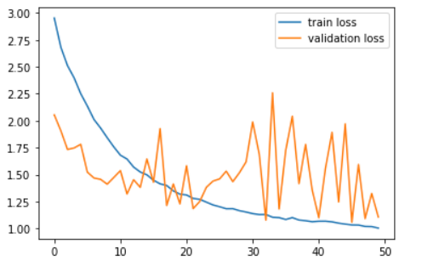
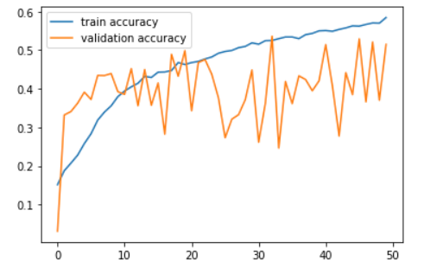
05
Modeling
batch/ epoch | activate | optimizer | train acc | train loss | val acc | val loss | test acc | test loss
64/50 | softmax | Adam | 0.5845 | 1.0043 | 0.5149 | 1.1067 | 0.5178 | 1.1257

Slide 20
05
Modeling
Convolution layer + Augment
Categorical crossentropy
1 Block
2 Block
3~5 Block
Fully Connected Classifier
Drop out (0.4)
BatchN
Maxpool
Flatten
Dense (64)
BatchN
Drop out (0.5)
Conv (64)
RMSProp
Conv (64)
BatchN
BatchN
Drop out (0.3)
Conv (64)
Maxpool
Batch Normaliztion
Conv (64)
Conv (64)
Batch Normaliztion
Augment

Slide 21
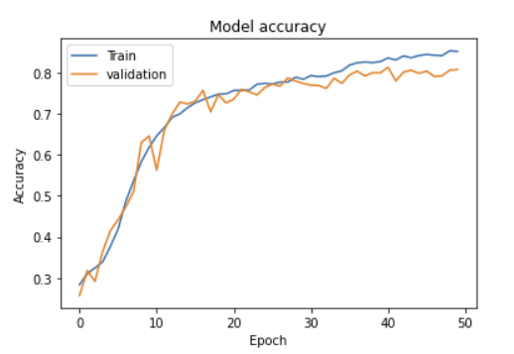
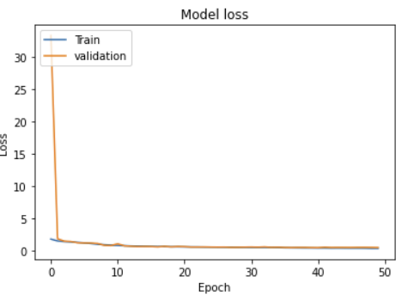
05
Modeling
batch/ epoch | activate | optimizer | train acc | train loss | val acc | val loss | test acc | test loss
64/50 | softmax | RMSprop | 0.8513 | 0.3879 | 0.8073 | 0.5149 | 0.8081 | 0.5113

Slide 22
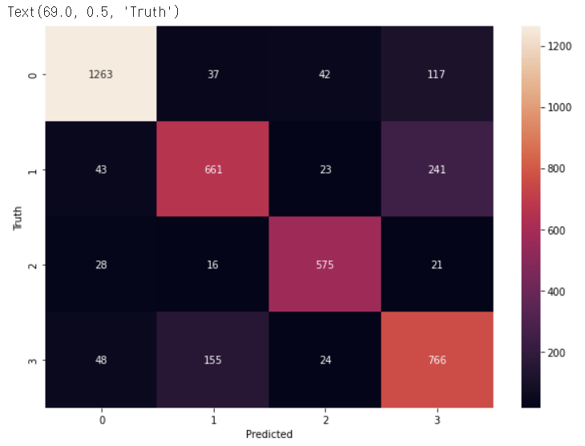
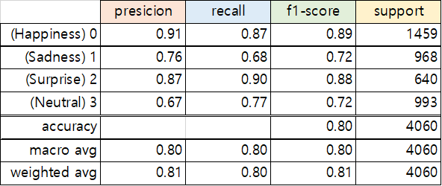
05
Modeling
Confusion matrix

Slide 23
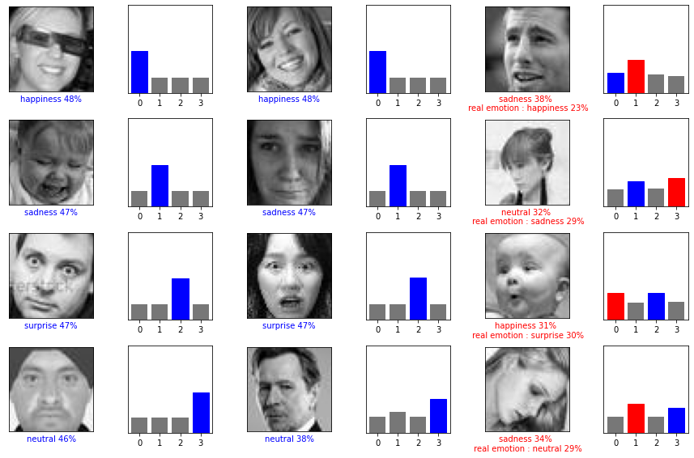
05
Modeling
Image test prediction

Slide 24
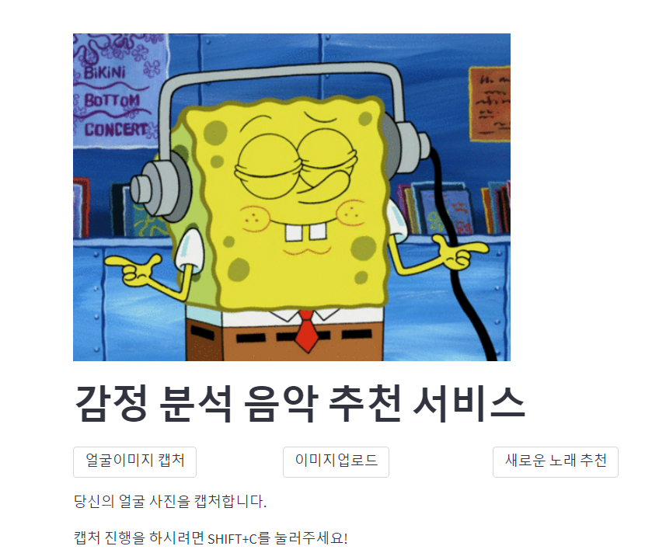
06
System Operator Guidelines
Main
Face image capture
Other songs recommendation
Photo upload

Slide 25
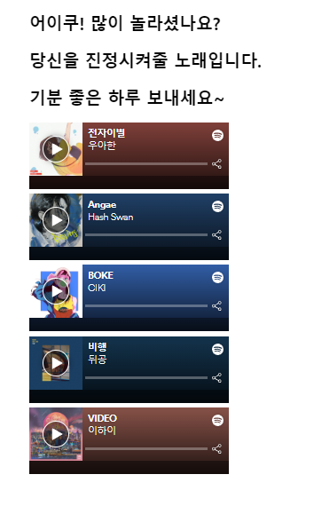
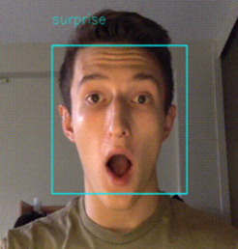
06
System Operator Guidelines
After Capturing, analyze facial emotions from the camera
A song recommendation to calm your heart down for your surprised feelings

Slide 26
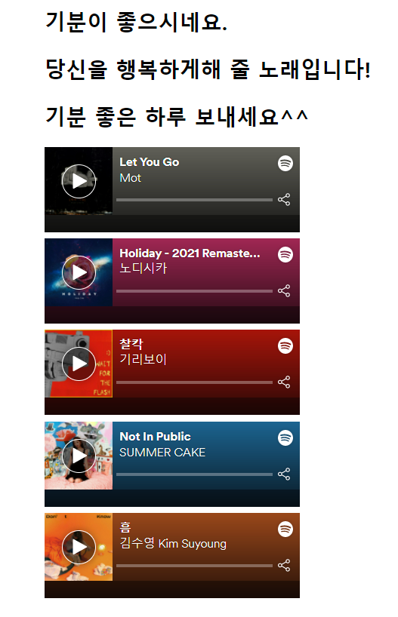
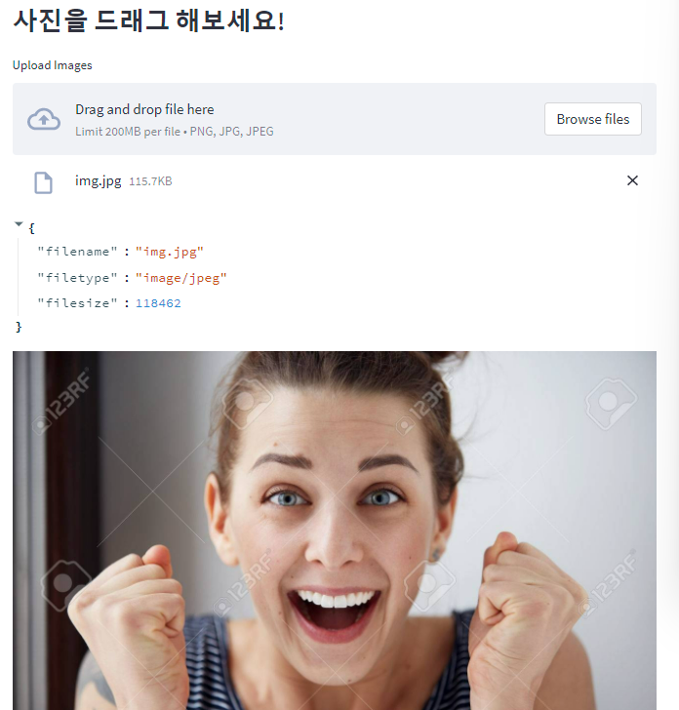
06
System Operator Guidelines
사진 업로드 기능
Photo Upload function
Recommend a happy song for happy emotions

Slide 27
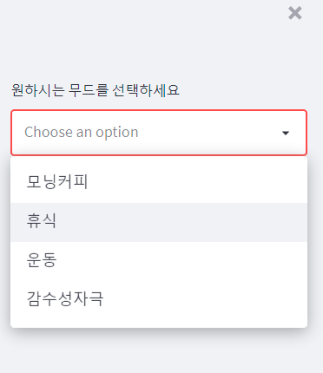
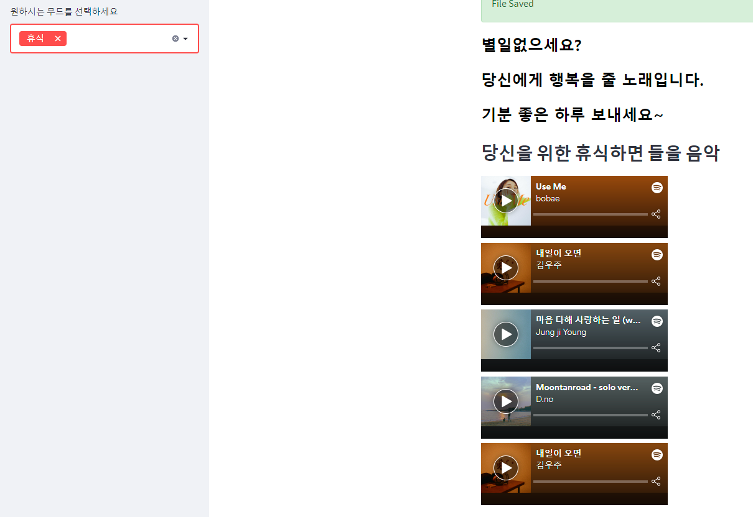
06
System Operator Guidelines
Neutral Emotion Selection Function
Choose the mood
Multiple selection possible
Morning coffee
Relaxing
Exercise
Heart Touching Songs

Slide 28
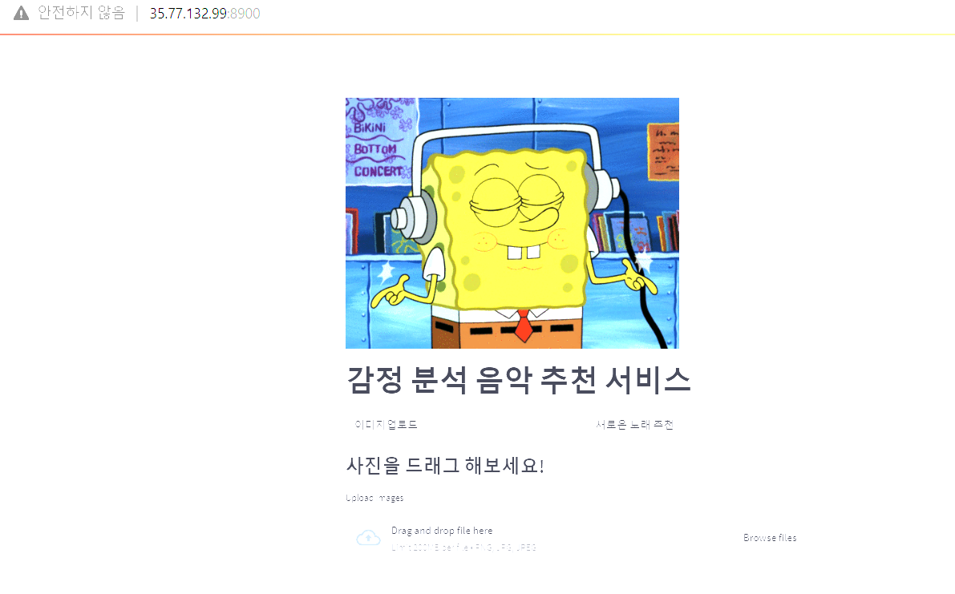
06
System Operator Guidelines
Web server

Slide 29
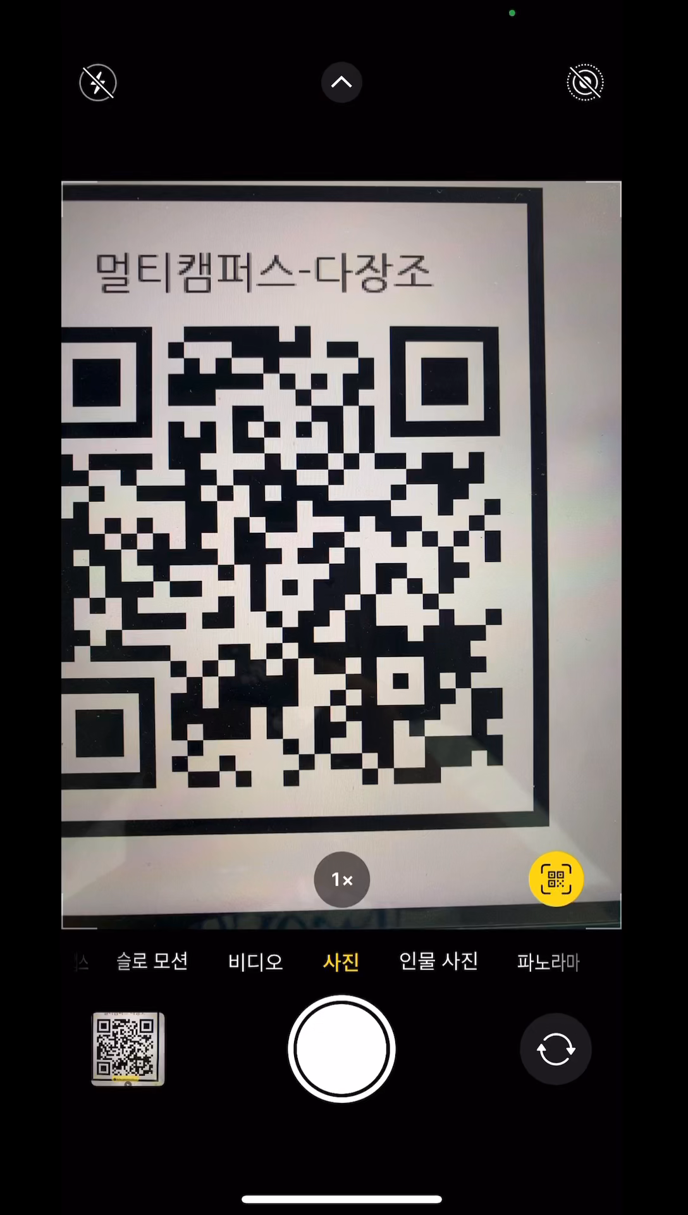
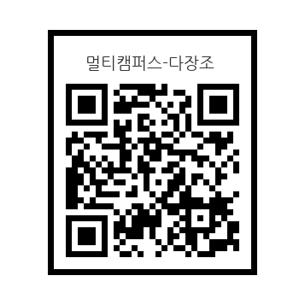
06
System Operator Guidelines
QR code

Slide 30
07
Problems and Solutions
On the web server, Image capture Function impossibility
Cause
Python OpenCV camera running problem on user's device
A
B
Solution plan
Solution plan
Reset camera capture part with JavaScript
Only photo upload analysis works on the web server

Slide 31
08
Conclusion and Review
A lot of human’s working is needed for convenient AI.
.
the need for a variety of languages
Streamlit is better for prototypes.

Slide 32
08
Conclusion and Review
Fewer people and less time
Communication and cooperation among team members
It is regrettable that various attempts could not be made due to the sudden decrease in the number of people. As the project deadline is approaching, it is very sorry that the cam drive could not be completed on the web.
It was a time to feel once again how important communication between team members is in a team project, and it was meaningful to be able to combine and produce good results
Bad
things
Good
things
Acquire a variety of skills and knowledge
A lack of planning
Through the project, I was able to study and learn knowledge that was not present in addition to each major. It was good to be able to understand deep learning and face recognition principles and to be able to access various technologies.
It took a lot of time to solve problems because specific plans and accurate information of tools were not identified in advance.

Slide 33
THANK YOU
Music Recommendation

